Slide 1

Enhancing Copper Industry Efficiency with Machine Learning
addressing Sales and Lead Challenges through Advanced Regression and Classification Models

Slide 2
Overview of Challenges in Copper Industry Data
The copper industry faces complexities in sales and pricing data, including skewness and noise. Manual predictions are hindered by time-consuming processes and suboptimal decisions.
Sales Data Challenges
Skewed and Noisy Data Issues
Lead Challenges
challenges faced by the copper industry in capturing leads and the need for a systematic approach to lead evaluation.

Slide 3
Solution
Machine Learning Regression Model
Content: Introducing a solution with machine learning regression models. Techniques such as data normalization, feature scaling, and outlier detection enhance accuracy, especially in dealing with skewed and noisy data.
Lead Classification Model solution:
Introducing a lead classification model that evaluates and categorizes leads based on their likelihood to convert into customers, using the STATUS variable.

Slide 4
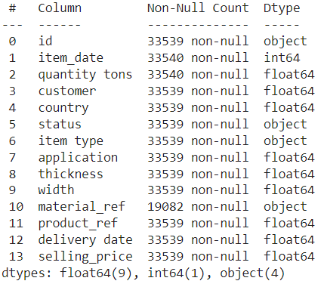
DATASET INFORMATION: TOTAL ROWS:33540 COLUMNS:14

Slide 5
About the Data
1. `id`: This column likely serves as a unique identifier for each transaction or item, which can be useful for tracking and record-keeping.
2. `item_date`: This column represents the date when each transaction or item was recorded or occurred. It's important for tracking the timing of business activities.
3. `quantity tons`: This column indicates the quantity of the item in tons, which is essential for inventory management and understanding the volume of products sold or produced.
4. `customer`: The "customer" column refers to the name or identifier of the customer who either purchased or ordered the items. It's crucial for maintaining customer relationships and tracking sales.
5. `country`: The "country" column specifies the country associated with each customer. This information can be useful for understanding the geographic distribution of customers and may have implications for logistics and international sales.
6. `status`: The "status" column likely describes the current status of the transaction or item. This information can be used to track the progress of orders or transactions, such as "Draft" or "Won."
7. `item type`: This column categorizes the type or category of the items being sold or produced. Understanding item types is essential for inventory categorization and business reporting.
8. `application`: The "application" column defines the specific use or application of the items. This information can help tailor marketing and product development efforts.
9. `thickness`: The "thickness" column provides details about the thickness of the items. It's critical when dealing with materials where thickness is a significant factor, such as metals or construction materials.
10. `width`: The "width" column specifies the width of the items. It's important for understanding the size and dimensions of the products.
11. `material_ref`: This column appears to be a reference or identifier for the material used in the items. It's essential for tracking the source or composition of the products.

Slide 6
TREATING THE DATA
Dealing with data in wrong format
for categorical variables, this step is ignored
Checking Nan values and shape after dealing with data in wrong format
Dealing with Missing Values
material_ref has large set of null values, so replacing them with unknown
deleting the remaining null values as they are less than 1% of data which can be neglected

Slide 7
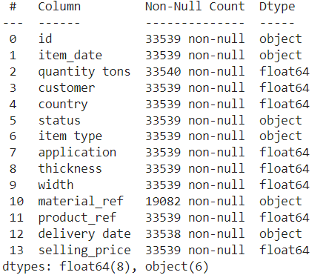
DATASET AFTER CLEANING

Slide 8
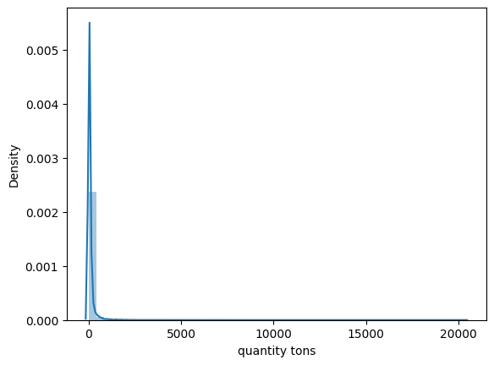
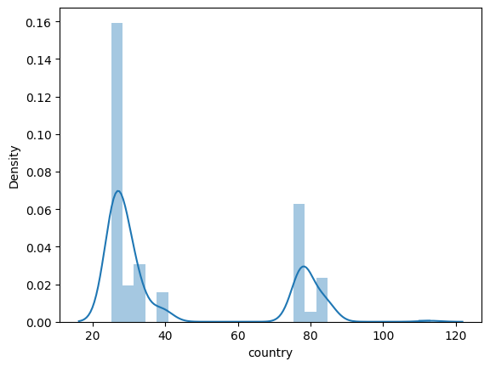
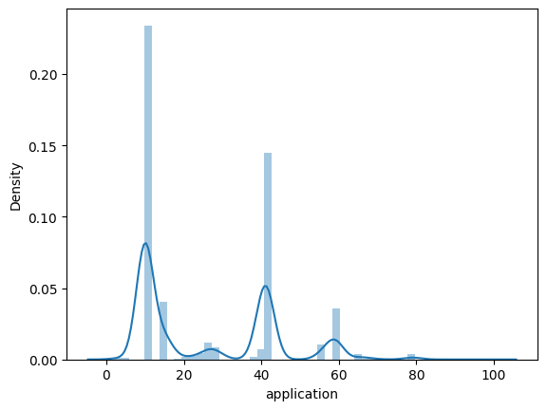
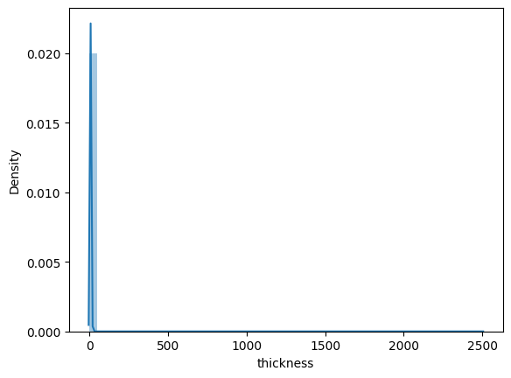
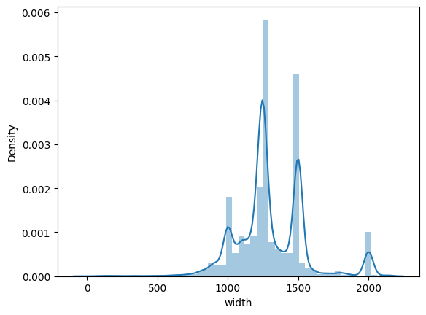
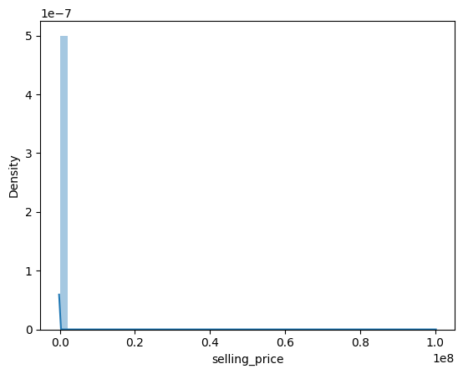
EDA AND PLOTTING

Slide 9
INFERENCE:
Quantity tons, thickness , selling price are highly skewed.
After checking skewness , we check for any negative values in thickness, selling price, and quantity tons and if present they are changed to zero.
TAKING LOGRAITHMS
Logarithms are taken to handle
Handling Skewed Data
Stabilizing Variance
Normalizing Data
Equalizing Effects
Interpretability

Slide 10
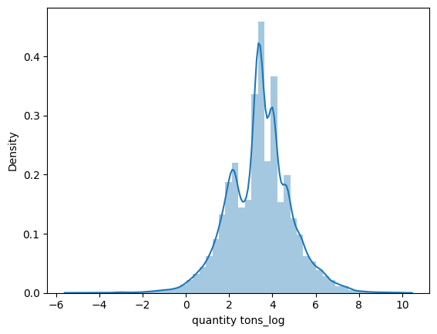
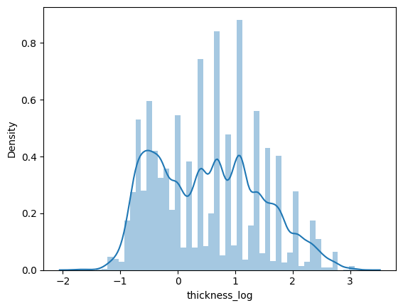
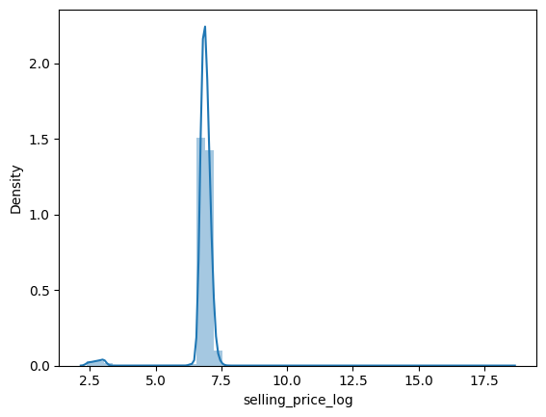
Plotting's for highly skewed data(thickness, selling price and quantity)after taking logarithm

Slide 11
MODEL BULDING: DECISION TREE REGRESSOR
1 Encode categorical features
2 Test and Train split
3 Define Hyperparameters for GridSearchCV
4 Train the DecisionTreeRegressor with best parameters 5 Evaluation metrics
6 Predict the selling price for new values
7 Save the DecisionTreeRegressor model
Decision Tree Regressor model for copper pricing modeling can be influenced by several factors like:
Non-Linearity in Data
Handling Complex Interactions
Interpretability
Feature Importance(understand which factors have the most significant impact on copper pricing, helping decision-makers prioritize their focus).
Robustness to Outliers(Decision trees are less sensitive to outliers, Decision Tree Regressor can provide more robust performance. )
Adaptability to Mixed Data Types
Less Assumption-Driven(Decision trees are less constrained by assumptions & it is advantageous when the true distribution of copper pricing data is not well-known or may deviate from typical assumptions).
Ensemble Learning Capabilities(Decision trees can be easily incorporated into ensemble models like Random Forests or Gradient Boosting, which often result in improved predictive performance compared to individual decision trees.)

Slide 12
encoding categorical variables(item_type, status)
One hot encoding is performed to item type and status and then added to independent features for model building.
independent features after encoding
'quantity tons_log', 'application', 'thickness_log', 'width','country','customer','product_ref’
Standard scalar is used (StandardScaler is a reliable choice due to its versatility, ease of use, and ability to preserve the distribution characteristics of the original features.)
The StandardScaler in scikit-learn standardizes features by removing the mean and scaling to unit variance
The resulting transformed features have a mean of 0 and a standard deviation of 1.
range of standardized values typically extends from negative to positive values, and the spread of the data is adjusted to have a standard deviation of 1.
Scaling is performed
why scaling?
Used in Distance-Based Algorithms (Scaling ensures that all features contribute proportionally to the distance computations)
Regularization(Scaling helps in preventing certain features from dominating due to their larger scale, ensuring fair treatment during regularization)

Slide 13
test and train split
Hyperparameters
Gridsearchcv(best model calculated)
evalution metrics are done for model building
Best hyperparameters: {'max_depth': 20,
'max_features': 'auto’,
'min_samples_leaf’: 1,
'min_samples_split': 5}
Mean squared error: 0.0065025406260660334
R-squared: 0.9848790878989241
Predicted selling price: [681.22489594]
Saving the model as pickle files.

Slide 14
DECISION TREE CLASSIFIER( To find the lead capturing)
If captured status is WON
If not captured status is LOST
DEPENDENT FEATURE(TARGET):'status’
INPENDENT FEATURES(quantity tons_log','selling_price_log','item type','application','thickness_log','width','country','customer’)
encoding categorical variables
SCALING
PREDICTING ACCURACY USING CONFUSION MATRIX
Accuracy: 0.9384288747346072
Confusion Matrix:
[[ 598 192]
[ 156 4706]]

Slide 15
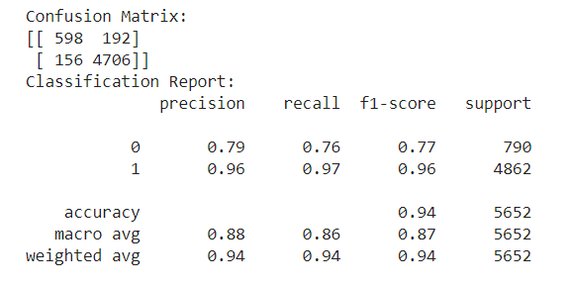
# Evalution Metrics
confusion_matrix, classification_report, roc_curve, auc
PLOTTING FOR ROC(RECEIVER OPERATING CHARECTERISTICS) AND AUC

Slide 16
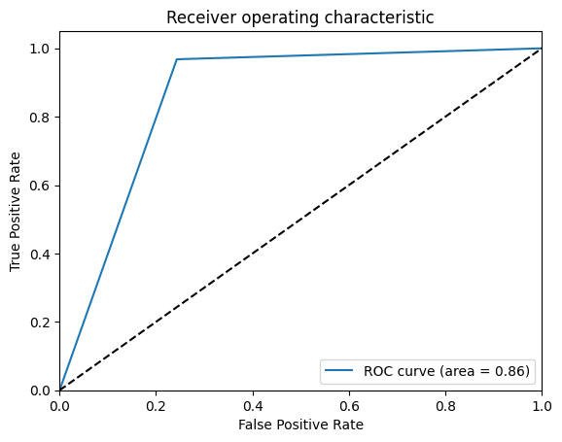
Predict the status for a new sample # 'quantity tons_log', 'selling_price_log','application', 'thickness_log', 'width','country','customer','product_ref']].value
if new_pred==1: print('The status is: Won') else: print('The status is: Lost’)
# Saving the model

Slide 17
The learning outcomes of this project are:
Developing proficiency in Python programming language and its data analysis libraries such as Pandas, NumPy, Matplotlib, Seaborn, Scikit-learn, and Streamlit.
Gaining experience in data preprocessing techniques such as handling missing values, outlier detection, and data normalization to prepare data for machine learning modeling.
Understanding and visualizing the data using EDA techniques such as boxplots, histograms, and scatter plots.
5.Learning and applying advanced machine learning techniques such as regression and classification to predict continuous and binary target variables, respectively.
6. Building and optimizing machine learning models using appropriate evaluation metrics and techniques such as cross-validation and grid search.
7. Experience in feature engineering techniques to create new informative representations of the data.
8. Developing a web application using the Streamlit module to showcase the machine learning models and make predictions on new data.
9. Understanding the challenges and best practices in the manufacturing domain and how machine learning can help solve them.

Slide 18
Conclusion: Enhancing Copper Industry Efficiency with Predictive Modeling
Improved Pricing Decisions
Lead Classification for Customer Acquisition
Interpretable and Trustworthy Models
Robustness and Adaptability
Future Directions
The copper modeling project marks a significant step toward optimizing operational efficiency, pricing strategies, and lead management within the industry.
The successful implementation of machine learning models opens avenues for data-driven decision-making, positioning the industry for sustainable growth and competitiveness in the evolving market landscape.

Slide 19
THANK YOU
NIVETHA ESWARAN

